Slide 1

7143CEM Mini-lecture 3-1c: Data Visualisation
School of Computing, Electronics and Mathematics Coventry University
7143CEM Programming for Data Science 2021/22 Semester 1

Slide 2
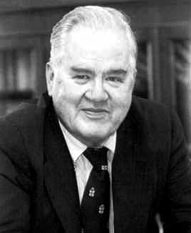
Exploratory Data Analysis (EDA)
Summarise the main characteristics of a dataset (both visually and using summary statistics)
Aim to discover patterns and propose hypotheses/models.
Ask the question: “What is going on here?”
Established by John Tukey (1915–2000) in his book Exploratory Data Analysis (1977).
Also invented the boxplot and terms “bit” and “software”.
Notes:
Reading: http://cll.stanford.edu/~langley/cogsys/behrens97pm.pdf

Slide 3

What is Exploratory Data Analysis?
Tukey often related EDA to detective work (collecting evidence and clues related to the central question in the case).
Role of the data scientist is to “listen” to the data in as many ways as possible until a plausible “story” of the data is apparent.
Notes:
Image from:
Reading: http://creative-wisdom.com/teaching/WBI/EDA.shtml

Slide 4
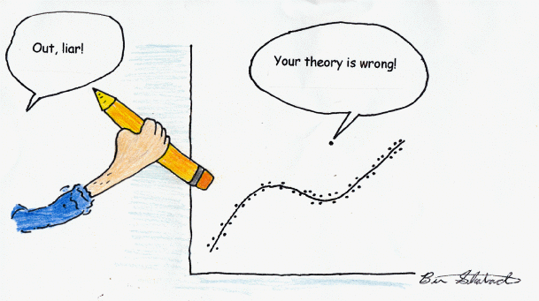
Why Data Visualisation?
To explore data and reveal:
Errors and anomalies
Relationship between variables
Structure
Complexity
Patterns
Clusters
Anything we can’t easily discover in other ways
Notes:
Image from: http://davidmlane.com/ben/outlier.gif

Slide 5
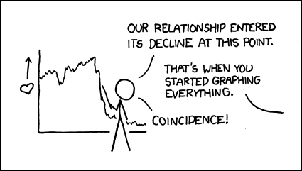
Why Data Visualisation?
To communicate
Present information concisely
Simplify complex ideas
Tell a story
Explain conclusions
Convey a message
Where is the dividing line between objective presentation of information and manipulation of your audience (propaganda)?
Notes:
Image from: https://xkcd.com/523/

Slide 6
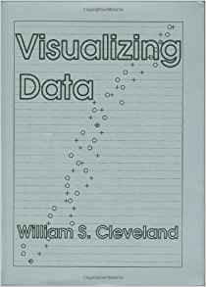
History of Data Visualisation
Started with simple cave drawings depicting the success of a hunt.
Prior to 1600, data visualisation existed mainly in the realm of maps.
William Cleveland’s book Visualizing Data (1993).
Modern dashboards connect to millions of rows of data.
Notes:
Reading: https://archive.org/details/visualizingdata00will/
Reading: https://www.dundas.com/resources/dundas-data-visualization-blog/brief-history-data-visualization
Reading: http://euclid.psych.yorku.ca/datavis.ca/papers/gfkl.pdf

Slide 7
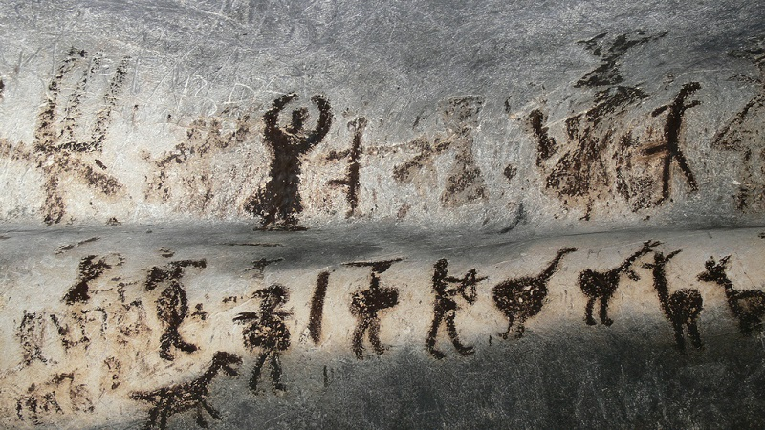
Magura Cave (Bulgaria)
6300BC–3000BC
Notes:
Image and reading: https://en.wikipedia.org/wiki/Magura_Cave

Slide 8
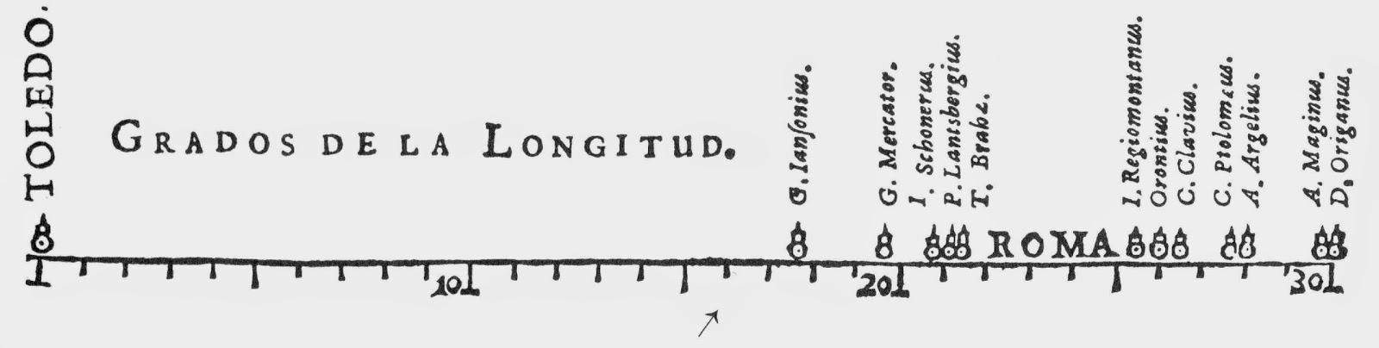
Michael van Langren (1598–1675)
Flemish astronomer, first known visual representation of statistical data (1644).
Spread of estimates of distance (in degrees longitude) between Toledo and Rome.
Notes:
Journal paper: https://doi.org/10.1198/tast.2010.09154

Slide 9
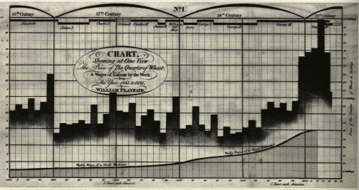
William Playfair (1759–1823)
Inventor of the line, area and bar charts (1786) and pie chart (1801).
Example: bar chart (1821) of price of wheat, weekly wages and reigning monarch over 1565–1820.

Slide 10
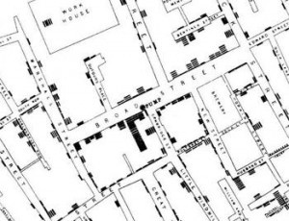
John Snow (1813–1858)
Cholera outbreaks in London (1854).
Studied the pattern of outbreak locations to identify the source as a public water pump on Broad Street (later found to be taking water from sewage-polluted sections of the Thames river).
Notes:
Reading: http://www.bbc.co.uk/history/historic_figures/snow_john.shtml

Slide 11
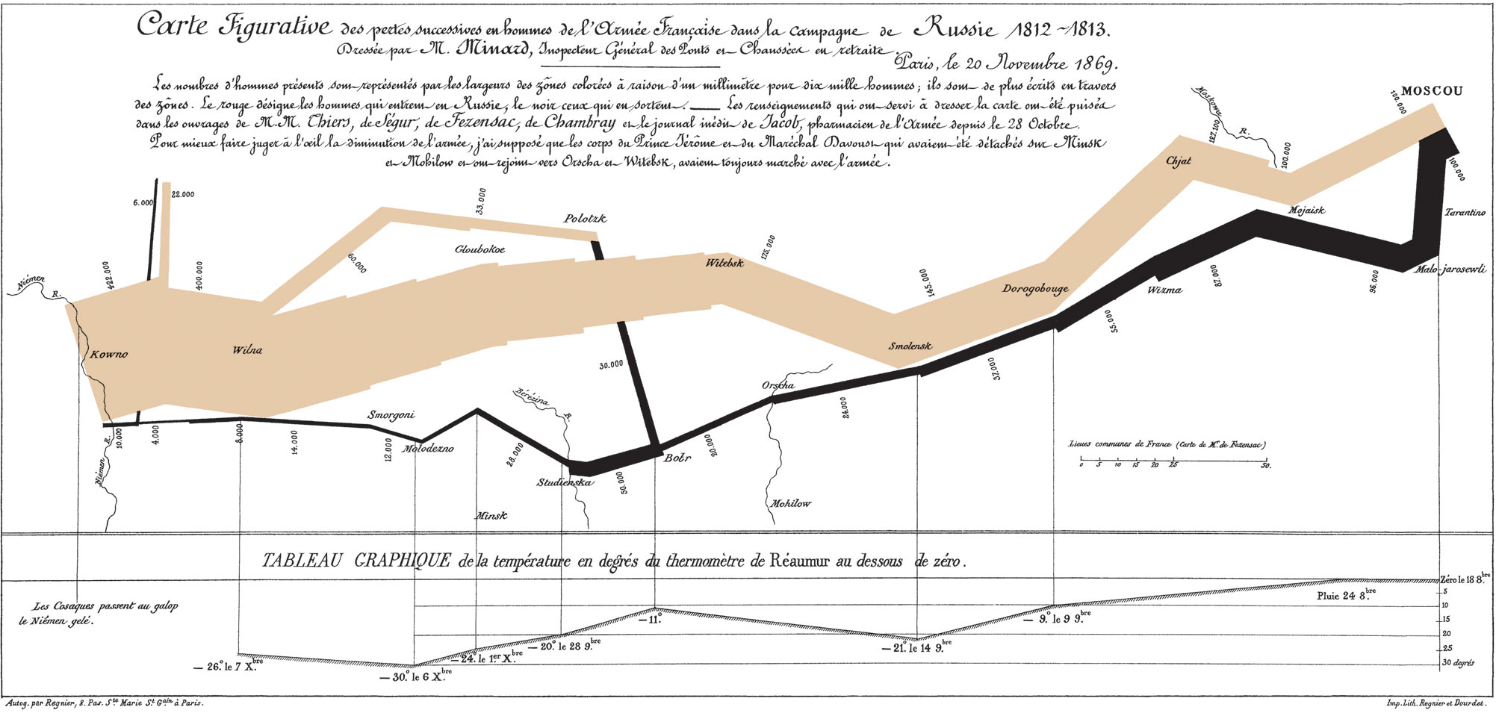
Charles Minard (1781–1870)
Napoleon’s Russian campaign of 1812 (“flow” of troops).
Notes:
Image from: https://en.wikipedia.org/wiki/Charles_Joseph_Minard
Displays six types of data in two dimensions: the number of Napoleon's troops; the distance traveled; temperature; latitude and longitude; direction of travel; and location relative to specific dates.

Slide 12
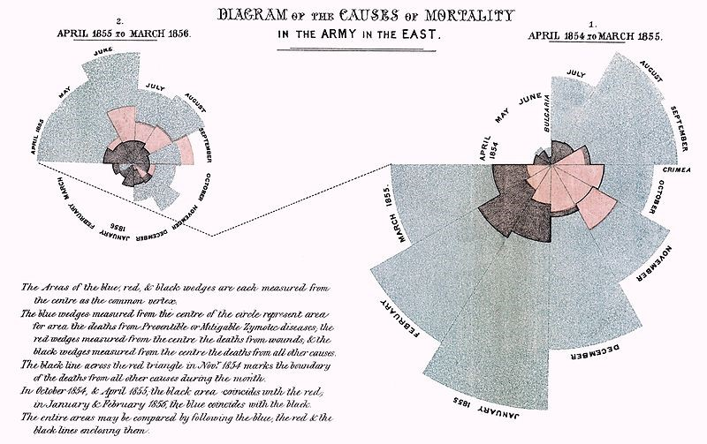
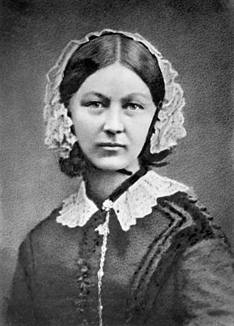
Florence Nightingale (1820–1910)
Crimean War (1853–56)
The “Lady with the Lamp”.
Nightingale rose or Coxcomb chart (polar area plot).
Notes:
Reading: https://en.wikipedia.org/wiki/Florence_Nightingale#Statistics_and_sanitary_reform
See also: https://datavizcatalogue.com/methods/nightingale_rose_chart.html

Slide 13
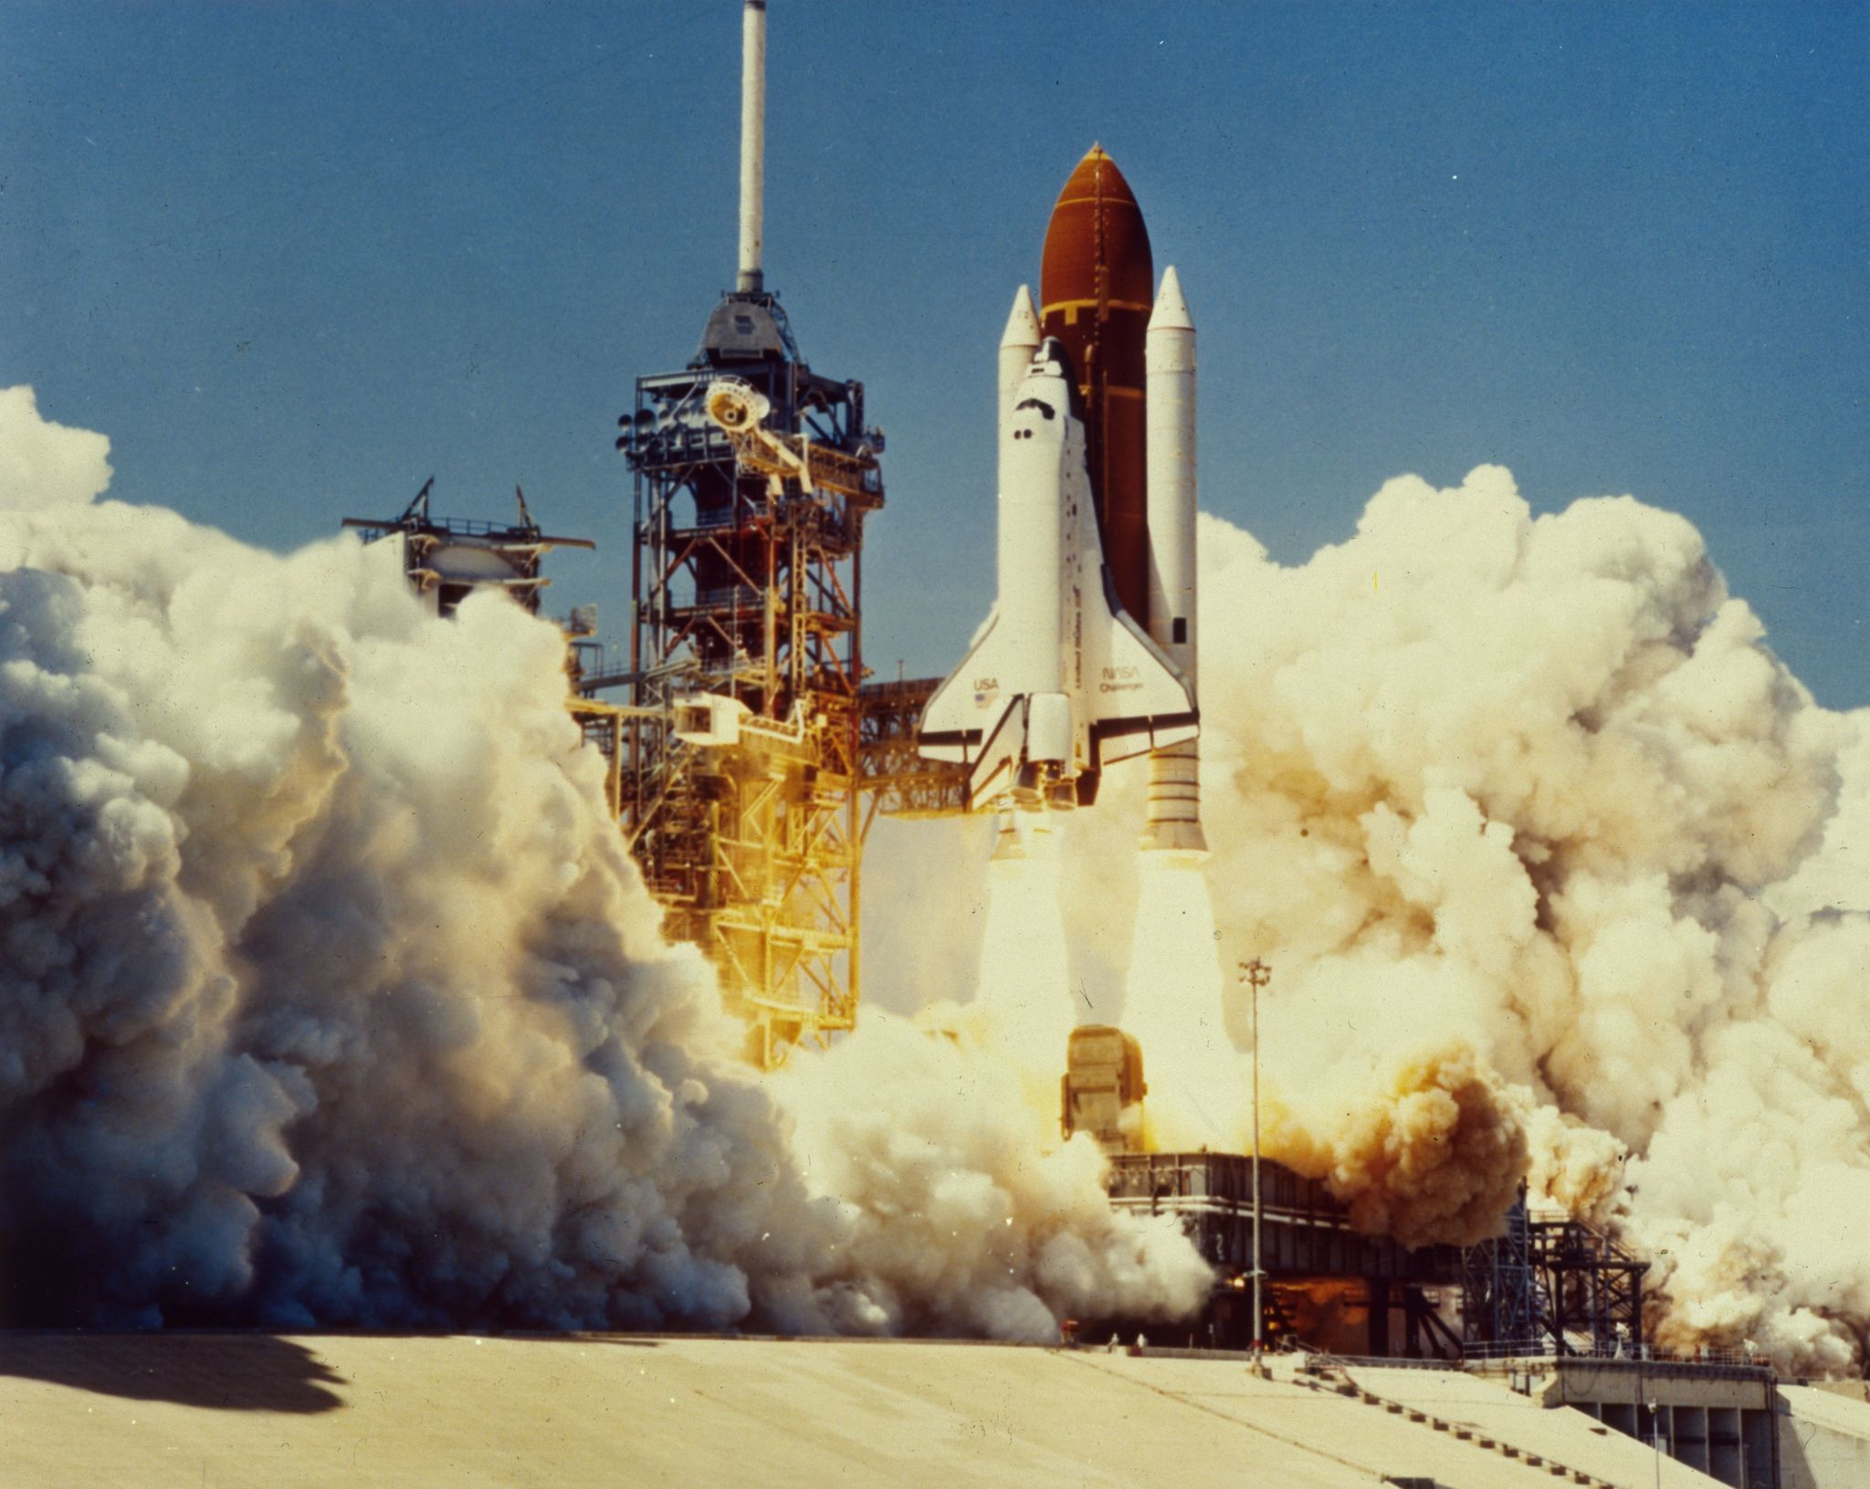
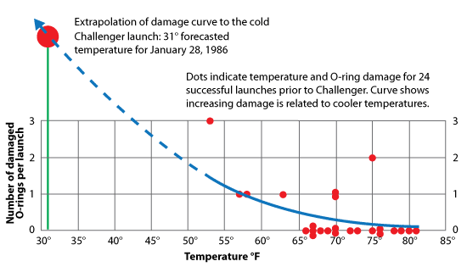

Space Shuttle Challenger Disaster (1986)
28 January 1986: temperatures close to -1$℃$ (30$℉$).
No test data to support successful launch (extrapolation).
Notes:
Graph from: https://www.workshopdigital.com/blog/youre-probably-using-wrong-graph/
Youtube: https://www.youtube.com/watch?v=yibNEcn-4yQ

Slide 14
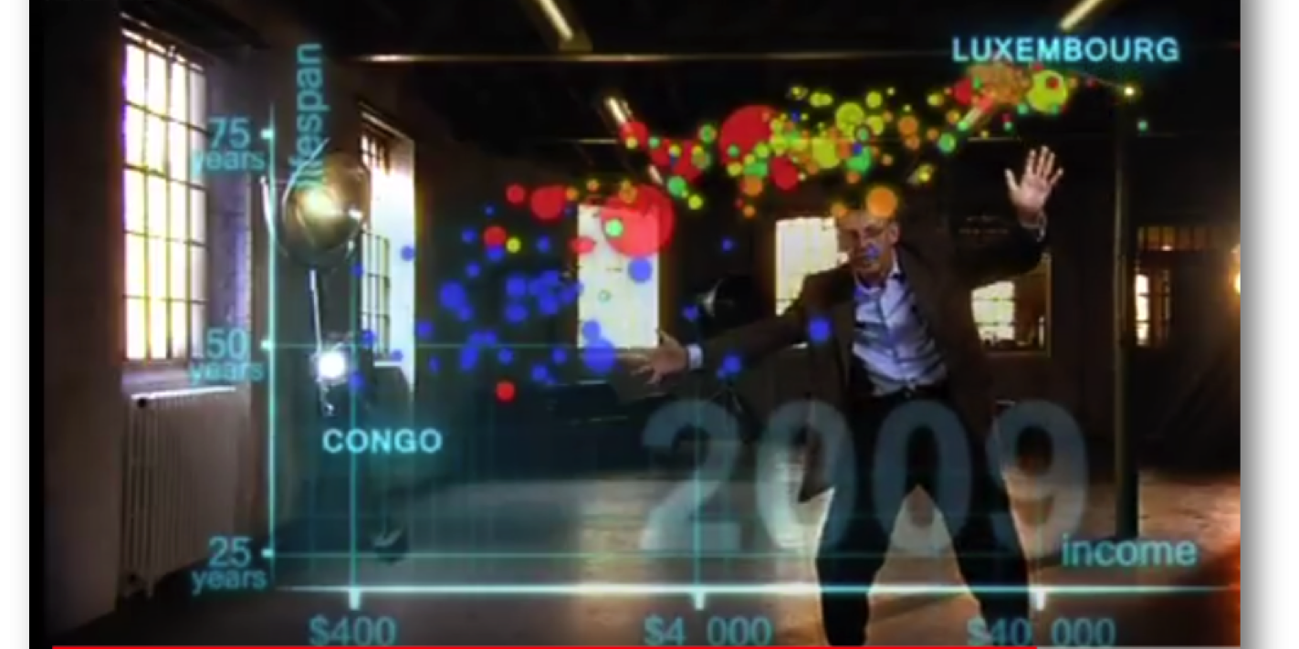
Prof Hans Rosling (1948–2017)
200 countries, 200 years, in four minutes: Joy of Stats
Notes:
Website: https://www.gapminder.org/tools/
Youtube: https://www.youtube.com/watch?v=ahp7QhbB8G4

Slide 15
Class Discussion Question
What impresses you about the youtube video "200 Countries, 200 years, in four minutes: Joy of Stats" by Prof Hans Rosling?
Follow up: A Brief History of Maps, Time Series, and Charts https://www.youtube.com/watch?v=lR8NWQnApwE
Follow up: Experiment with https://www.gapminder.org/tools/

